Slide 1

Advanced Topics
in Geospatial Analysis

Slide 2
Case Study: Investigation of Geothermal Potential with Machine Learning in Mainland Portugal
Supervisors:
Roberto Henriques
Vicente Tang
Filiberto Pla
Matheus Nascimento
matheus.lpd.nascimento@gmail.com
19/05/2022

Slide 3
Presentation Structure
1 Introduction
2 Literature Review
3 Methodology
4 Results
5 Discussions
6 Conclusions
Bibliographic References

Slide 4
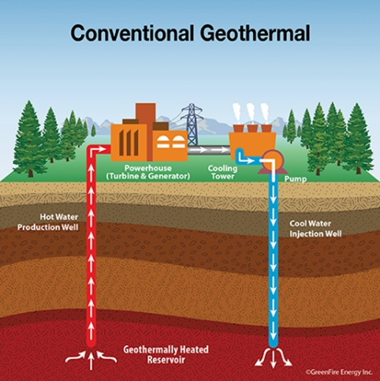
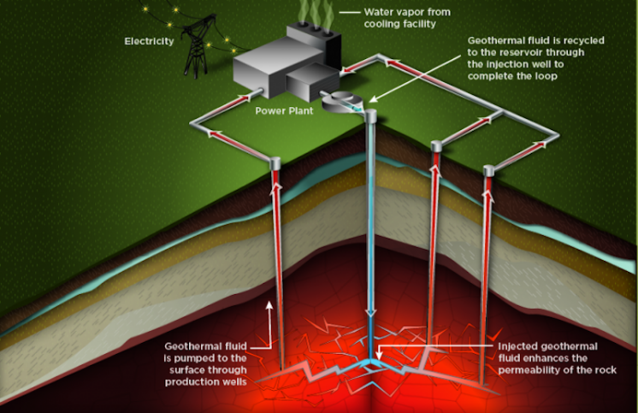
Introduction
Geothermal resources:
Heat stored inside the Earth’s crust
Hot ground water
Heat in subsurface layers (EGS)
Used to generate electricity
Used directly
Heating of buildings and industrial processes
Renewable, cleaner and relatively constant
www.greenfireenergy.com
www.thinkgeoenergy.com

Slide 5
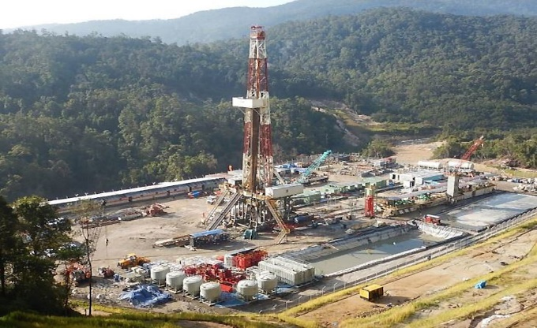
Introduction
Geothermal exploration:
Search for places with hot water or heat that can be economically explored
Requires many resources
Traditionally achieved through:
Field surveys and drilling campaigns
Geophysical, geological and geochemical analysis
www.thinkgeoenergy.com

Slide 6


Introduction
Methods to locate promising areas and reduce risks:
GIS-based spatial analysis
Geo statistics
GIS-based Multi criteria decision analysis
Machine Learning models

Slide 7
Introduction
Study area: Mainland Portugal
Continental land with 89 015 km²
Low enthalpy systems explored for direct use
Recent efforts to: improve knowledge, foment future geothermal explorations.
Geothermal Atlas of Portugal (Ramalho & Correia, 2015)
Promising theoretical EGS potential in the Iberian Peninsula (Chamorro et al., 2014)

Slide 8
Introduction
This study couples GIS and ML to assess the potential for geothermal exploration by predicting:
Geothermal gradient (°C/km)
Surface heat flow density (mW/m²)

Slide 9
Introduction
Goal and objectives:
Evaluate if labels can be predicted using publicly available data on geological, hydrogeological, geophysical, terrain, and weather information by ML models
Compare the results of two different algorithms
Identify promising features to predict labels and interpretate possible relationships among them

Slide 10
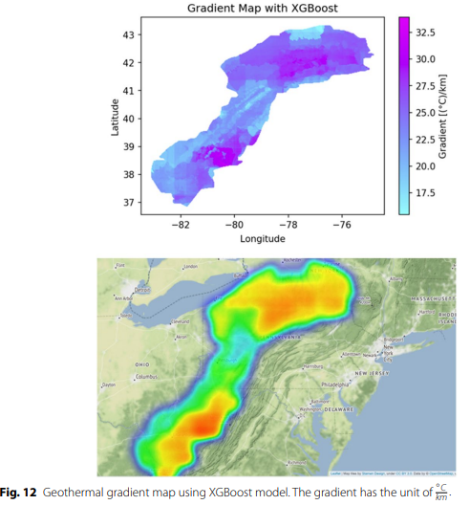
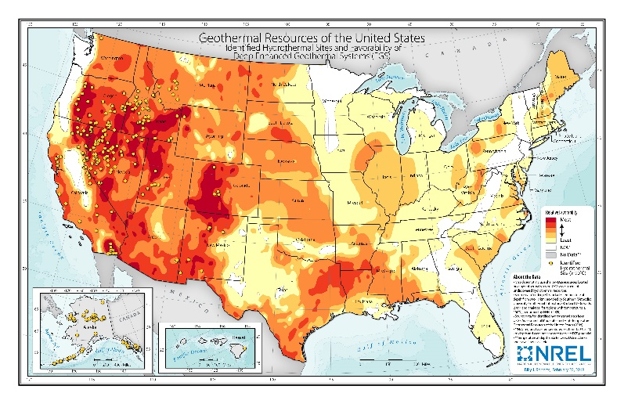
Literature Review
Geothermal Potential:
Estimated calculating important physical parameters of the ground and subsurface
Using different weighted criteria data to rank different areas regarding their potentiality
(Shahdi et all., 2021)
www.nrel.gov

Slide 11
Literature Review
GIS-based techniques:
Studies successfully estimated suitability using MCDA:
AHP (Tinti et al., 2018, Omwenga, 2020)
Weighted overlay (Trumpy et al., 2015, Fahil et al., 2020)
Managed to identify or confirm important criteria data linked to geothermal potential
However, they are not used to estimate physical parameters values. ML is being used for this purpose

Slide 12
Literature Review
Machine Learning:
Provided promising results in analysis of renewable energies exploration and suitability (Shahab & Singh, 2019, Lai et al., 2020)
In the Geothermal field:
Predict important thermal properties (Arola et al., 2019; Assouline et al., 2019; Gangwani et al., 2020; Mohamed et al., 2015; Shahdi et al., 2021)
Classify suitability indexes (Coro & Trumpy, 2020)

Slide 13
Literature Review
Machine Learning algorithms:
Random Forests (RF)
Extreme Gradient Boosting (XGB)
Gradient Boosted Regression Tree
Maximun Entropy Modeling
Artificial Neural Networks
Ridge Regression

Slide 14
Literature Review
Geothermal Related Variables/Criteria:
Lithological and structural setting
Drainage density
Soil texture
Permeability
Bouguer gravity anomaly
Surface air temperature
Seismic activity

Slide 15

Methodology

Slide 16
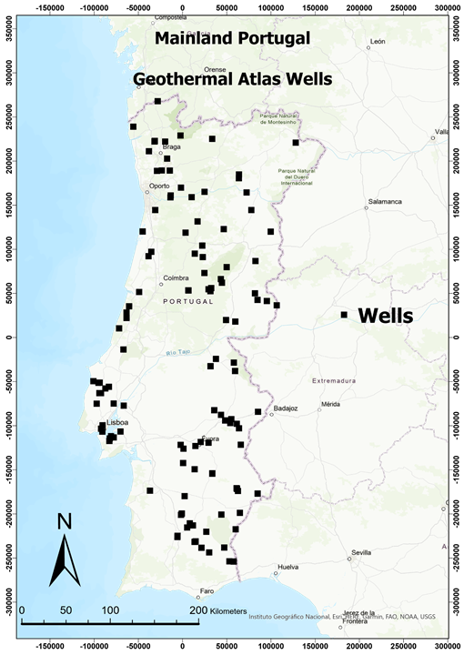
Methodology
Collected Data:
Labels were provided by LNEG and from the Geothermal Atlas of Portugal
138 points from different wells where geothermal gradient and surface heat flow density were measured

Slide 17
Methodology
Collected Data:

Slide 18
Methodology
Data preparation:
Projected to ETRS 1989 Portugal TM06 coordinate system
Clipped to cover Mainland Portugal
Aggregated in two vector grids:
5x5 km spatial resolution
2,5x2,5 km spatial resolution
Grids created resampling the DEM. Elevation, latitude and longitude of the centroids were added as features.

Slide 19
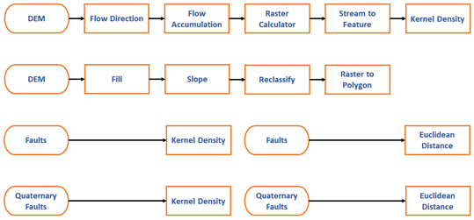
Methodology
Data preparation:

Slide 20
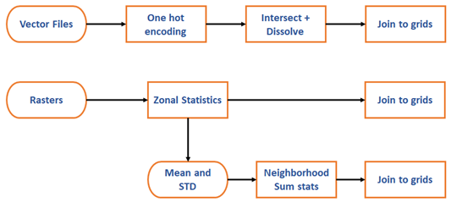
Methodology
Data preparation
Categorical raster converted in Shapefiles
Raster with very low spatial resolution resampled
Missing values filled with nearest neighbors

Slide 21
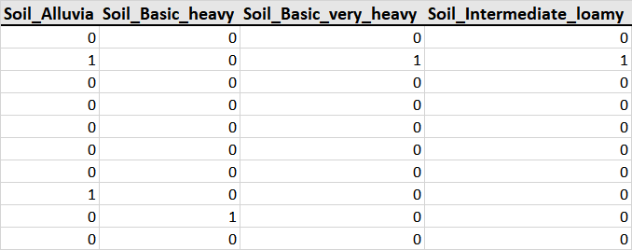
Methodology
Data preparation
One hot encoding

Slide 22
Methodology
Data preparation
Categorical raster converted in Shapefiles
Raster with very low spatial resolution resampled
Missing values filled with nearest neighbors

Slide 23
Methodology
Labels were summarized within the grids and outliers were removed following the 3*sigma rule
Geothermal Gradient (°C/km)
All |  |  | Outliers removed
Grids: | 2.5x2.5 km | 5x5 km | Grids: | 2.5x2.5 km | 5x5 km
count | 117 | 109 | count | 114 | 107
mean | 21,977 | 22,003 | mean | 21,406 | 21,573
std | 6,364 | 6,12 | std | 5,338 | 5,275
min | 10 | 10,448 | min | 10 | 10,448
max | 48 | 48 | max | 37 | 37
25% | 17,38 | 17,383 | 25% | 17,245 | 17,382
50% | 21 | 21 | 50% | 20,8 | 20,6
75% | 26 | 24,7 | 75% | 24,467 | 24,512
Surface Heat Flow Density (mW/m²)
All |  |  | Outliers removed
Grids: | 2.5x2.5 km | 5x5 km | Grids: | 2.5x2.5 km | 5x5 km
count | 117 | 109 | count | 115 | 108
mean | 63,852 | 63,42 | mean | 62,15 | 62,305
std | 22,673 | 21,446 | std | 18,538 | 18,095
min | 25 | 25 | min | 25 | 25
max | 183,84 | 183,84 | max | 114,863 | 116,65
25% | 50,55 | 50,55 | 25% | 50,333 | 50,441
50% | 60,842 | 60,99 | 50% | 60 | 60,916
75% | 73,578 | 72,5 | 75% | 73,306 | 72,304

Slide 24
Methodology
RF and XGB Regressor were utilized to predict both labels
Scikit Learn Python Module and Xgboost library
Modelling and evaluation:
5-fold Cross Validation
R², RMSE, and MAE
Grid Search CV – find best hyperparameters
Feature Selection with Features importance and Select from Model
Permutation Importance

Slide 25
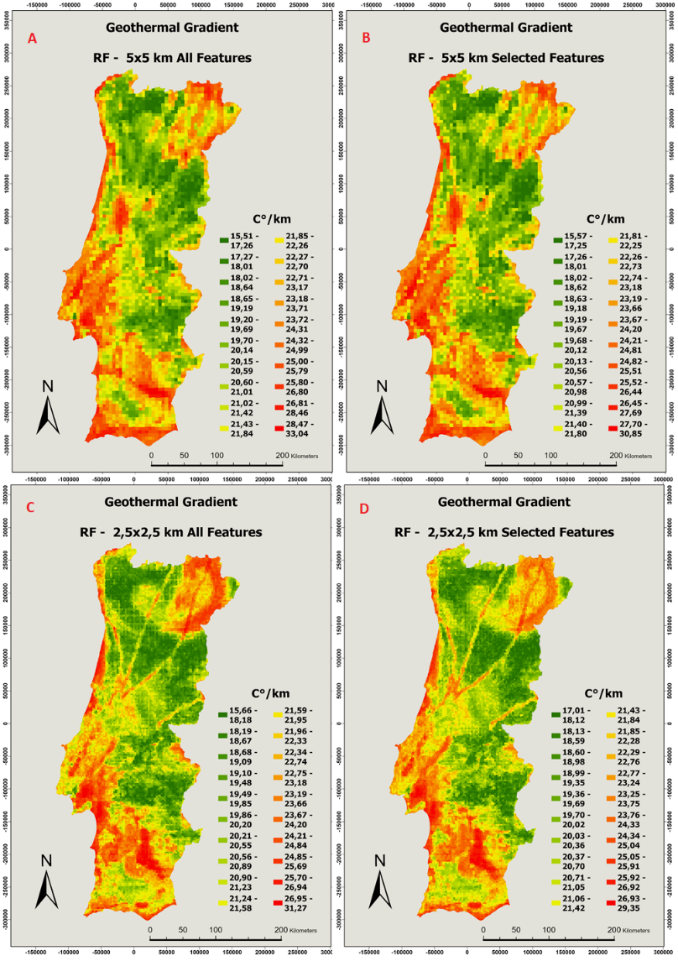
Results
Random Forests Models:
Values range: 15,57 – 30,85 °C/km

Slide 26
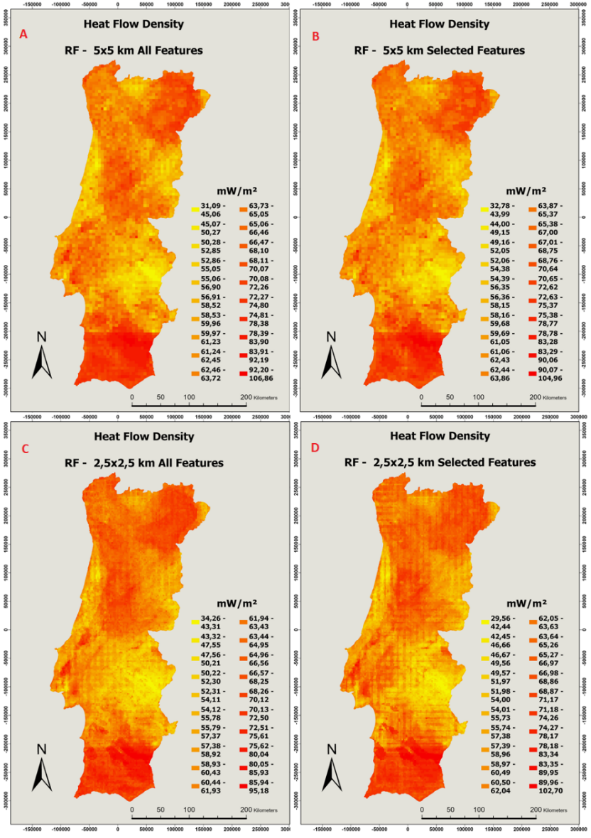
Results
Random Forests Models:
Values range: 32,78 – 104,96 mW/m²

Slide 27
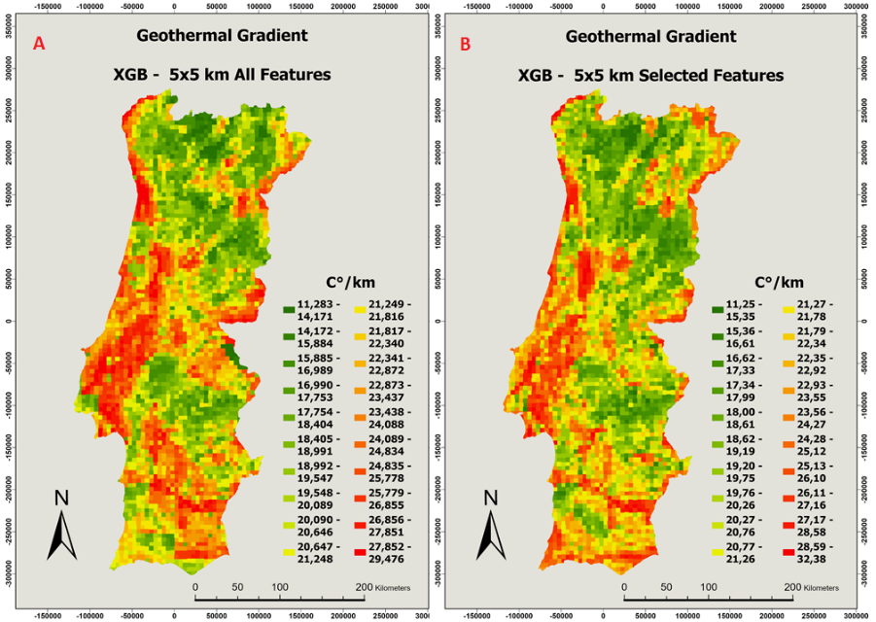
Results
XGB Models:
Values range: 11,25 – 32,38 °C/km

Slide 28
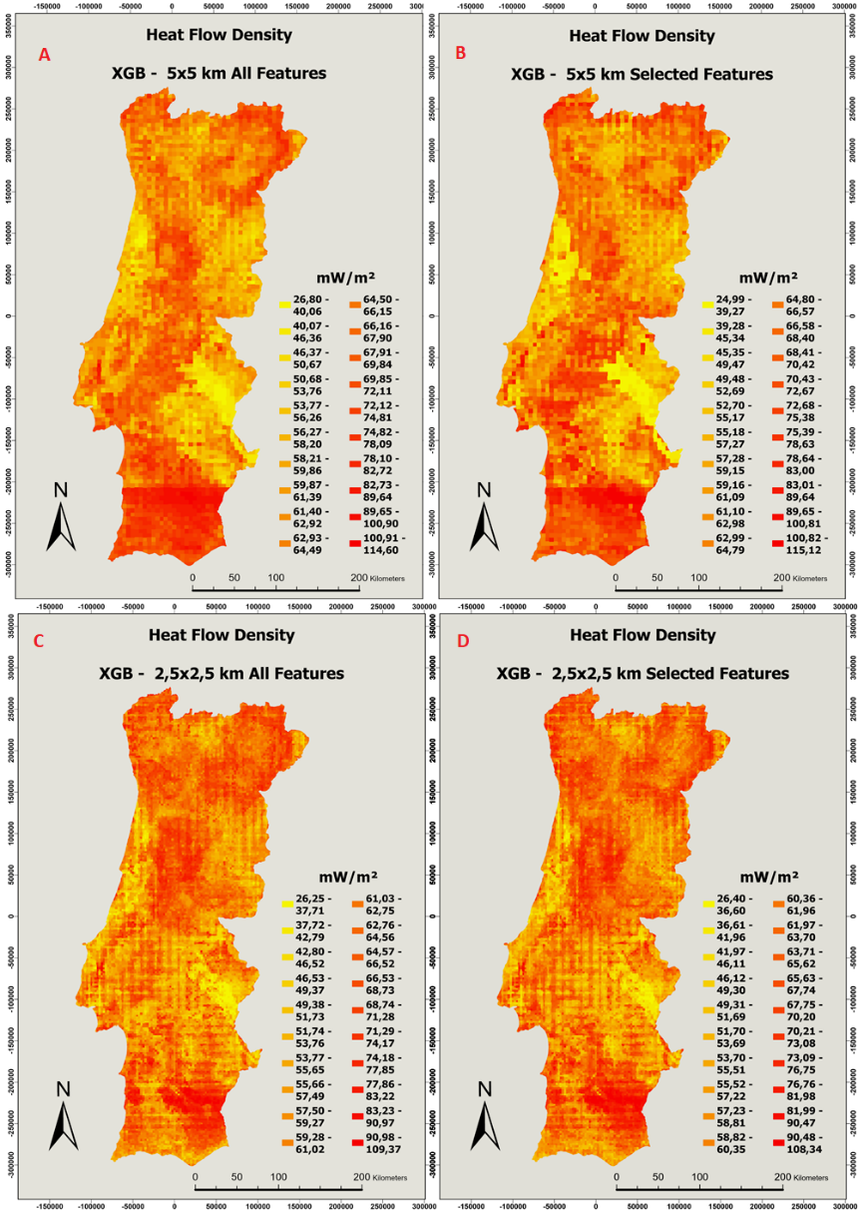
Results
XGB Models:
Values range: 24,99 – 115,12 mW/m²

Slide 29
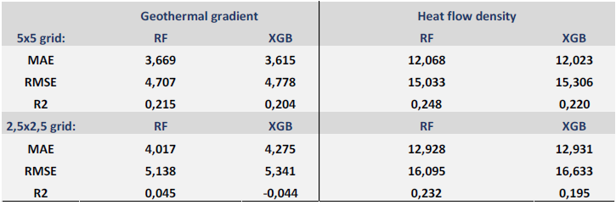
Discussion
Random Forests performed slightly better than XGB
Lower RMSE
Overall, lower MAE
Higher R²
Better results achieved with data aggregated into the lower spatial resolution grid (5x5 km)
This could be due to the presence of data sources with low spatial resolution used as features in the modelling

Slide 30
Discussion
The values of RMSE are relatively high and indicate that models’ generalization capacity is not too strong
However, the models were able to predict the overall spatial distribution of low and high values correctly
MAE suggests the maps were able to detect potential zones. Lowest MAE predicting geothermal gradient and surface heat flow density was 3,61 C°/km and 12,02 mW/m², respectively
As an example, Shahdi et al., (2021) achieved:
MAE scores of 5,6 and 7 (C°/km) with XGB and DNN, respectively. (Comparing predicted geothermal gradient and temperature at specific depths)
MAE score of 3,21 °C and RMSE of 4,94 with XGB, and MAE of 3,25 °C and RMSE of 5.01 with RF. (When evaluating the models with their main dataset to predict subsurface temperatures)

Slide 31
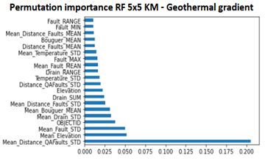
Discussion
Geothermal Gradient:
Neighbors Std of distance to quaternary faults was given the highest score in both importance calculations (feature importance and permutation importance)
Among the most important features, the criteria were:
distance to quaternary faults
elevation
density and distance to faults
temperature
Bouguer anomaly
density of drainages
Permutation Importance
Random Forests 5x5 km Geothermal Gradient
Weight | Feature
0.2288 ± 0.0849 | Mean_Distance_QAFaults_STD
0.0610 ± 0.0349 | Mean_Elevation
0.0539 ± 0.0074 | Mean_Fault_STD
0.0428 ± 0.0154 | OBJECTID
0.0338 ± 0.0111 | Mean_Bouguer_MEAN
0.0319 ± 0.0048 | Mean_Drain_STD
0.0281 ± 0.0118 | Mean_Distance_Faults_STD
0.0254 ± 0.0072 | Drain_SUM
0.0229 ± 0.0038 | Drain_RANGE
0.0208 ± 0.0093 | Elevation
0.0202 ± 0.0064 | Distance_QAFaults_STD
0.0186 ± 0.0093 | Temperature_STD
0.0168 ± 0.0065 | Fault_MAX
0.0148 ± 0.0044 | Mean_Temperature_STD
0.0137 ± 0.0086 | Mean_Fault_MEAN
0.0136 ± 0.0053 | Bouguer_MEAN
0.0135 ± 0.0065 | Mean_Distance_Faults_MEAN
0.0131 ± 0.0026 | Fault_RANGE
0.0122 ± 0.0045 | Distance_Faults_MEAN
0.0122 ± 0.0036 | Fault_STD

Slide 32
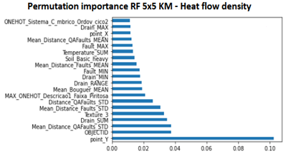
Discussion
Surface heat flow density:
Latitude had highest importance score in both importance calculations
Neighbors Std of distance to quaternary faults also had great importance
The most important features were:
latitude
distance to quaternary faults
distance and density of faults
density of drainages
soil texture (coarse)
soil composition (basic heavy)
lithology (Pyrite belt)
geochronology systems (Cambrian Ordovician)
Bouguer anomaly
temperature
Permutation Importance
Random Forests 5x5 km Heat Flow Density
Weight | Feature
0.0977 ± 0.0205 | point_Y
0.0429 ± 0.0107 | Mean_Distance_QAFaults_STD
0.0393 ± 0.0130 | OBJECTID
0.0320 ± 0.0045 | Drain_SUM
0.0302 ± 0.0083 | Texture_3
0.0292 ± 0.0085 | Distance_QAFaults_STD
0.0270 ± 0.0044 | Mean_Distance_Faults_STD
0.0215 ± 0.0039 | Drain_RANGE
0.0209 ± 0.0065 | MAX_ONEHOT_Descricao1_Faixa_Piritosa
0.0178 ± 0.0069 | Fault_MIN
0.0168 ± 0.0027 | Drain_MIN
0.0167 ± 0.0060 | Mean_Bouguer_MEAN
0.0133 ± 0.0048 | Mean_Distance_Faults_MEAN
0.0119 ± 0.0020 | Fault_MAX
0.0118 ± 0.0026 | Mean_Distance_QAFaults_MEAN
0.0118 ± 0.0034 | Mean_Drain_STD
0.0116 ± 0.0037 | Temperature_SUM
0.0115 ± 0.0036 | Soil_Basic_heavy
0.0112 ± 0.0036 | Drain_MAX
0.0110 ± 0.0045 | ONEHOT_Sistema_C_mbrico_

Slide 33
Discussion
Geological, hydrogeological and geophysical parameters were the most important features
Surface heat flow density is more influenced by surface properties than geothermal gradient. Soil texture and composition, and lithology (distinct thermal conductivities) are related parameters
The presence of high values of heat flow density in the south of Portugal and in the Pyrite-belt could be one of the factors that contributed to the great importance given to latitude

Slide 34
Discussion
Geothermal gradient is more related to subsurface parameters
However, they could be linked to the presence of faults, especially recent (quaternary) faults, high density of drainages and lower Earth’s crust thickness (Bouguer anomaly)
In the prediction maps, the influence given to quaternary faults can be seen by higher values close to where there are fault traces

Slide 35
Discussion
Limitations and future work:
Only CV, No extra dataset for validation
Errors associated with estimations and measurements
More errors where there are no training data
Improving the accuracy of the models is likely to be achieved with:
More and better spatially distributed training data
Fitting into the model other important features related to geothermal parameters:
Physical and chemical parameters of the ground
Remote sensing images such as thermal infra red, radar and multispectral images
Test other ML models (DNN, CNN)
Comparisons with geo statistics
However, it is not able to be used for modeling

Slide 36
Conclusion
Two ensemble machine learning algorithms to predict crucial thermal parameters of the surface and subsurface of Mainland Portugal
Prediction maps were able to target regions with higher geothermal potential and can be applied to aid geothermal exploration surveys
Important features were identified and confirmed the relevance of geological, hydrogeological and geophysical data, especially distance to quaternary faults
Comparing RF and XGB revealed slightly better results overall with RF
Comparing the grids revealed better achievements with lower spatial resolution (5x5 km)

Slide 37
Bibliographic References
Ammann, M. W., Walker, A. M., Stackhouse, S., Wookey, J., Forte, A. M., Brodholt, J. P., & Dobson, D. P. (2014). Variation of thermal conductivity and heat flux at the Earth’s core mantle boundary. Earth and Planetary Science Letters, 390, 175–185. https://doi.org/10.1016/j.epsl.2014.01.009
Arola, T., Korhonen, K., Martinkauppi, A., Leppäharju, N., Hakala, P., Ahonen, L., & Pashkovskii, M. (2019). Creating shallow geothermal potential maps for Finland using finite element simulations and machine learning. European Geothermal Congress 2019, June, 6.
Assouline, D., Mohajeri, N., Gudmundsson, A., & Scartezzini, J. L. (2019). A machine learning approach for mapping the very shallow theoretical geothermal potential. Geothermal Energy, 7(1). https://doi.org/10.1186/s40517-019-0135-6
Badino, G. (2005). Underground drainage systems and geothermal flux. Acta Carsologica, 34(2), 277–316. https://doi.org/10.3986/ac.v34i2.261
Barbier, E. (2002). Geothermal energy technology and current status: An overview. Renewable and Sustainable Energy Reviews, 6(1–2), 3–65. https://doi.org/10.1016/S1364-0321(02)00002-3
Bignall, G., Milicich, S., Ramirez, E., Rosenberg, M., Kilgour, G., & Rae, A. (2010). Geology of the Wairakei-Tauhara Geothermal System, New Zealand. Proceedings World Geothermal Congress, November 2019, 25–29.
Booysen, R., Gloaguen, R., Lorenz, S., Zimmermann, R., & Nex, P. A. M. (2021). Geological Remote Sensing. In Encyclopedia of Geology (2nd ed.). Elsevier Inc. https://doi.org/10.1016/b978-0-12-409548-9.12127-x
L. Breiman, "Random forests", Mach. Learn., vol. 45, no.1, pp. 5-32, Oct. 2001. doi:10.1023/A:1010933404324
Chamorro, C. R., García-Cuesta, J. L., Mondéjar, M. E., & Linares, M. M. (2014). An estimation of the enhanced geothermal systems potential for the Iberian Peninsula. Renewable Energy, 66, 1–14. https://doi.org/10.1016/j.renene.2013.11.065
Corniello A., D. D. (2012). Hydrogeology key role in a geothermal exploration in southern Italy. January. http://www.researchgate.net/publication/255486060_Hydrogeology_key_role_in_a_geothermal_exploration_in_southern_Italy
Coro, G., & Trumpy, E. (2020). Predicting geographical suitability of geothermal power plants. Journal of Cleaner Production, 267, 121874. https://doi.org/10.1016/j.jclepro.2020.121874
Fahil, A. S., Ghoneim, E., Noweir, M. A., & Masoud, A. (2020). Integration of well logging and remote sensing data for detecting potential geothermal sites along the gulf of Suez, Egypt. Resources, 9(9). https://doi.org/10.3390/RESOURCES9090109
Gangwani, P., Soni, J., Upadhyay, H., & Joshi, S. (2020). A Deep Learning Approach for Modeling of Geothermal Energy Prediction. International Journal of Computer Science and Information Security, 18(1), 62–65.
González, D. L., & Rodríguez-Gonzálvez, P. (2019). Detection of geothermal potential zones using remote sensing techniques. Remote Sensing, 11(20). https://doi.org/10.3390/rs11202403
Han, M., Feng, Y., Zhao, X., Sun, C., Hong, F., & Liu, C. (2019). A Convolutional Neural Network Using Surface Data to Predict Subsurface Temperatures in the Pacific Ocean. IEEE Access, 7, 172816–172829. https://doi.org/10.1109/ACCESS.2019.2955957
Kotsiantis, S. B., Zaharakis, I. D., & Pintelas, P. E. (2006). Machine learning: A review of classification and combining techniques. Artificial Intelligence Review, 26(3), 159–190. https://doi.org/10.1007/s10462-007-9052-3
Lai, J. P., Chang, Y. M., Chen, C. H., & Pai, P. F. (2020). A survey of machine learning models in renewable energy predictions. Applied Sciences (Switzerland), 10(17). https://doi.org/10.3390/app10175975
Lerche, I. (1991). Temperature dependence of thermal conductivity and its impact on assessments of heat flux. Pure and Applied Geophysics PAGEOPH, 136(2–3), 191–200. https://doi.org/10.1007/BF00876371
Lund, J. W., & Freeston, D. H. (2001). World-wide direct uses of geothermal energy 2000. Geothermics, 30(1), 29–68. https://doi.org/10.1016/S0375-6505(00)00044-4
Merembayev, T., Yunussov, R., & Yedilkhan, A. (2019). Machine learning algorithms for classification geology data from well logging. 14th International Conference on Electronics Computer and Computation, ICECCO 2018, 9–13. https://doi.org/10.1109/ICECCO.2018.8634775
Mock, J. E., Tester, J. W., & Wright, P. M. (1997). Geothermal energy from the earth: Its potential impact as an environmentally sustainable resource. Annual Review of Energy and the Environment, 22(1), 305–356. https://doi.org/10.1146/annurev.energy.22.1.305
Mohamed, H. S., Abdel Zaher, M., Senosy, M. M., Saibi, H., el Nouby, M., & Fairhead, J. D. (2015). Correlation of Aerogravity and BHT Data to Develop a Geothermal Gradient Map of the Northern Western Desert of Egypt using an Artificial Neural

Slide 38
Bibliographic References
Network. Pure and Applied Geophysics, 172(6), 1585–1597. https://doi.org/10.1007/s00024-014-0998-1
Nguyen, A., Pasquier, P., & Marcotte, D. (2017). Borehole thermal energy storage systems under the influence of groundwater flow and time-varying surface temperature. Geothermics, 66, 110–118. https://doi.org/10.1016/j.geothermics.2016.11.002
Olasolo, P., Juárez, M. C., Morales, M. P., Damico, S., & Liarte, I. A. (2016). Enhanced geothermal systems (EGS): A review. Renewable and Sustainable Energy Reviews, 56, 133–144. https://doi.org/10.1016/j.rser.2015.11.031
Omwenga, B. M. (2020). Geothermal Well Site Suitability Selection Using Geographic Information Systems (GIS) and Remote Sensing: Case Study of the Eburru Geothermal Field. 45th Workshop on Geothermal Reservoir Engineering, 1, 1–6.
F. Pedregosa et al., Scikit-learn: Machine Learning in Python, JMLR 12, pp. 2825–2830, 2011.
Pukelsheim. (1994). The three sigma rule. American Statistician, 48(2), 88–91. https://doi.org/10.1080/00031305.1994.10476030
Ramalho, E. C. (2014). O papel do atlas geotérmico nacional no fomento da exploração da energia geotérmica em Portugal continental. Comunicacoes Geologicas, 101, 833–836.
Ramalho, E., Correia, A., 2015. Atlas Geotérmico de Portugal Continental [mapa] https://geoportal.lneg.pt/mapa/?mapa=AtlasGeotermico [20 Fev, 2022].
Rezvanbehbahani, S., Stearns, L. A., Kadivar, A., Walker, J. D., & van der Veen, C. J. (2017). Predicting the Geothermal Heat Flux in Greenland: A Machine Learning Approach. Geophysical Research Letters, 44(24), 12,271-12,279. https://doi.org/10.1002/2017GL075661
Robertson, E. C. (1988). Thermal Properties of Rocks. US Department of the Interior: Geological Survey, 88–441.
S. Angra and S. Ahuja, “Machine learning and its applications: A review,” in 2017 International Conference on Big Data Analytics and Computational Intelligence (ICBDAC). IEEE, 2017, pp. 57–60.
Shahab, A., & Singh, M. P. (2019). Comparative analysis of different machine learning algorithms in classification of suitability of renewable energy resource. Proceedings of the 2019 IEEE International Conference on Communication and Signal Processing, ICCSP 2019, 2013, 360–364. https://doi.org/10.1109/ICCSP.2019.8697969
Shahdi, A., Lee, S., Karpatne, A., & Nojabaei, B. (2021). Exploratory analysis of machine learning methods in predicting subsurface temperature and geothermal gradient of Northeastern United States. Geothermal Energy, 9(1). https://doi.org/10.1186/s40517-021-00200-4
Sun, Z., Jiang, B., Li, X., Li, J., & Xiao, K. (2020). A data-driven approach for lithology identification based on parameter-optimized ensemble learning. Energies, 13(15), 1–15. https://doi.org/10.3390/en13153903
Suwai, J. (2009). Basic Hydrogeology in Geothermal Systems. Short Course V on Exploration for Geothermal Resources, 1–9.
Tester, J. (2007). Congressional Testimony for. 1–13.
Tianqi Chen and Carlos Guestrin. 2016. XGBoost: A scalable tree boosting system. In Proceedings of the 22nd ACM SIGKDD International Conference on Knowledge Discovery and Data Mining. 785–794.
Tinti, F., Kasmaee, S., Elkarmoty, M., Bonduà, S., & Bortolotti, V. (2018). Suitability evaluation of specific shallow geothermal technologies using a GIS-Based multi criteria decision analysis implementing the analytic hierarchic process. Energies, 11(2). https://doi.org/10.3390/en11020457
Trumpy, E., Donato, A., Gianelli, G., Gola, G., Minissale, A., Montanari, D., Santilano, A., & Manzella, A. (2015). Data integration and favourability maps for exploring geothermal systems in Sicily, southern Italy. Geothermics, 56(January 2021), 1–16. https://doi.org/10.1016/j.geothermics.2015.03.004
van der Meer, F., Hecker, C., van Ruitenbeek, F., van der Werff, H., de Wijkerslooth, C., & Wechsler, C. (2014). Geologic remote sensing for geothermal exploration: A review. International Journal of Applied Earth Observation and Geoinformation, 33(1), 255–269. https://doi.org/10.1016/j.jag.2014.05.007
Zhang, L., & Zhan, C. (2017). Machine Learning in Rock Facies Classification: An Application of XGBoost. January, 1371–1374. https://doi.org/10.1190/igc2017-351

Slide 39
Methodology
RF and XGB Regressor were utilized to predict both labels
Scikit Learn Python Module and Xgboost library
Modelling and evaluation:
5-fold Cross Validation
R², RMSE, and MAE
Grid Search CV – find best hyperparameters
Feature Selection with Features importance and Select from Model
Permutation Importance
Show Jupyter Notebook

Slide 40
ML with Geospatial Data
Suggestions:
GIS (ArcGIS, QGIS) – can be used to preprocess data and for visualization
Python – preprocess and ML modelling
Pandas and Numpy
Matplotlib, Seaborn, Plotly
Scikit-Learn
Feature engineering
Feature selection
Dimensionality reduction
ML models
ETC
Keras and Tensor flow - deep learning
Geospatial libraries
Other programming languages and libraries
Softwares such as weka, orange, etc

Slide 41

Thank you!

